Slide 1
Defending with Shared Resources on a Network
Minming Li (City University of Hong Kong)
Joint work with Long Tran-Thanh (University of Warwick)
and Xiaowei Wu (University of Macau)

Slide 2
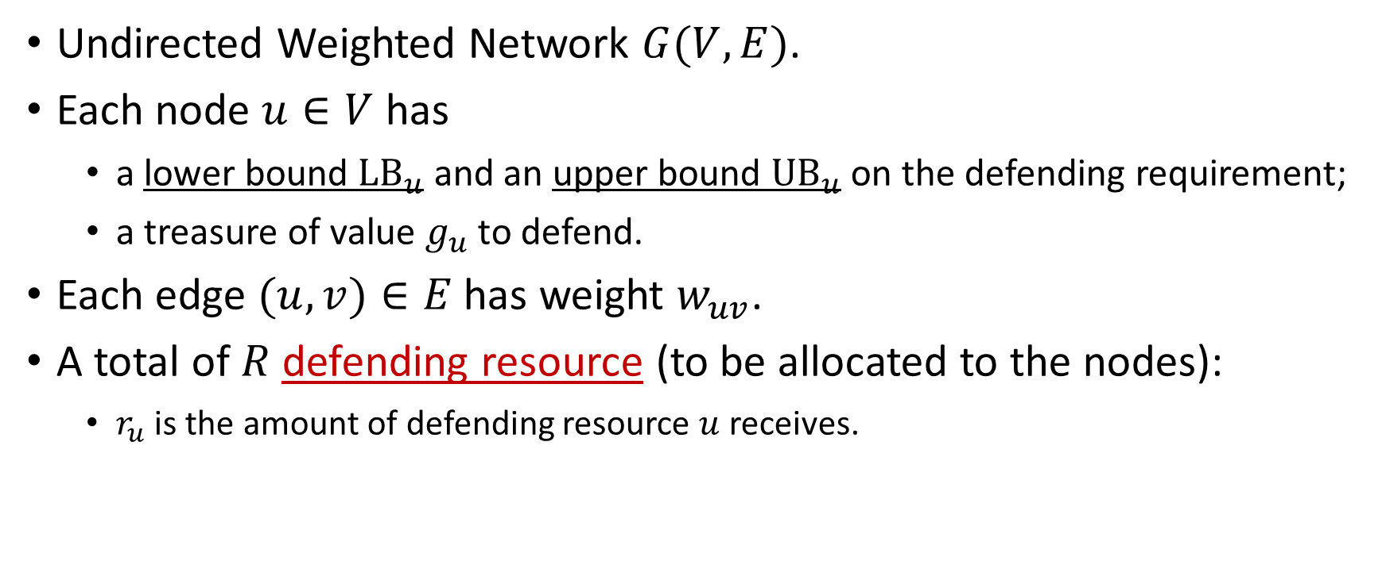
Network Defending Problem
Undirected Weighted Network $G(V,E)$.
Each node $u∈V$ has
a lower bound $LB_{u}$ and an upper bound ${UB}_{u}$ on the defending requirement;
a treasure of value $g_{u}$ to defend.
Each edge $(u,v)∈E$ has weight $w_{uv}$.
A total of $R$ defending resource (to be allocated to the nodes):
$r_{u}$ is the amount of defending resource $u$ receives.

Slide 3
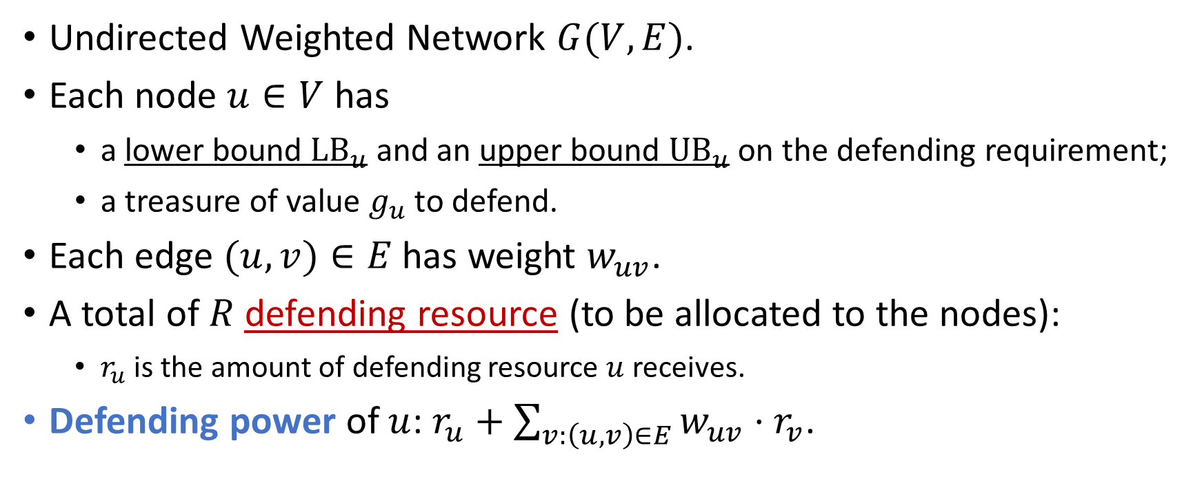
Network Defending Problem
Undirected Weighted Network $G(V,E)$.
Each node $u∈V$ has
a lower bound $LB_{u}$ and an upper bound ${UB}_{u}$ on the defending requirement;
a treasure of value $g_{u}$ to defend.
Each edge $(u,v)∈E$ has weight $w_{uv}$.
A total of $R$ defending resource (to be allocated to the nodes):
$r_{u}$ is the amount of defending resource $u$ receives.
Defending power of $u$: $r_{u}+\sum_{v:\left(u,v\right)∈E}{w_{uv}⋅r_{v}}$.

Slide 4


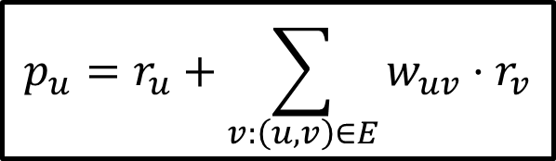
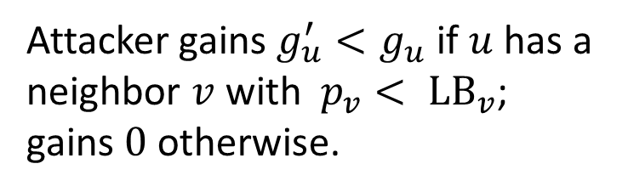


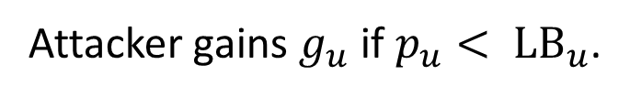

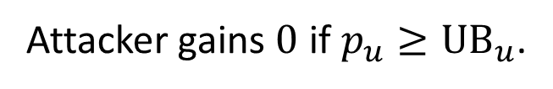


Network Defending Problem
$$w_{uv}$$
Attacker gains $0$ if ${p_{u}≥UB}_{u}$.
$$v$$
$$u$$
$${UB}_{u}$$
Attacker gains $g_{u}^{′}<g_{u}$ if $u$ has a neighbor $v$ with ${p_{v}< LB}_{v}$; gains $0$ otherwise.
$$r_{v}$$
$$r_{u}$$
$$p_{u}=r_{u}+\sum_{v:\left(u,v\right)∈E}{w_{uv}⋅r_{v}}$$
$${LB}_{u}$$
Attacker gains $g_{u}$ if ${p_{u}< LB}_{u}$.
Objective: allocate defending resource to minimize the loss due to a single attack.

Slide 5
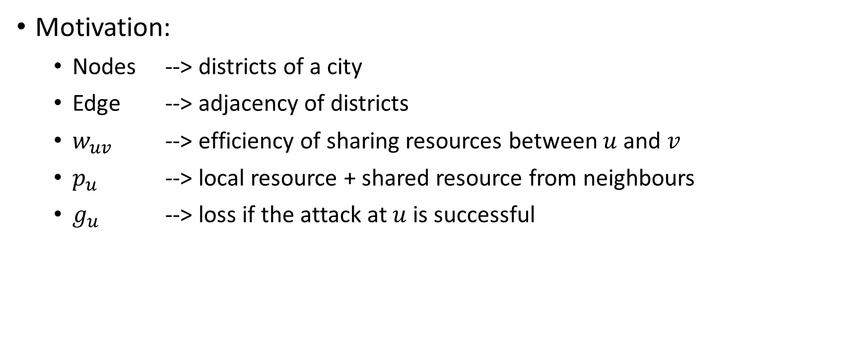
Network Defending Problem
Motivation:
Nodes --> districts of a city
Edge --> adjacency of districts
$w_{uv}$ --> efficiency of sharing resources between $u$ and $v$
$p_{u}$ --> local resource + shared resource from neighbours
$g_{u}$ --> loss if the attack at $u$ is successful

Slide 6
Network Defending Problem
Example:
1
2
3
4
5
6

Slide 7



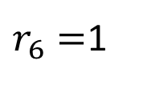


Network Defending Problem
Example:
$$r_{1}=2$$
$$r_{2}=1$$
$$r_{3}=2$$
1
2
3
4
5
6
$$r_{4}=1$$
$$r_{5}=4$$
$r_{6}=$1

Slide 8

Network Defending Problem
Example: $w=0.5$ for all edges
$$r_{1}=2$$
$$r_{2}=1$$
$$r_{3}=2$$
1
2
3
4
5
6
$$r_{4}=1$$
$$r_{5}=4$$
$r_{6}=$1

Slide 9






Network Defending Problem
Example: $w=0.5$ for all edges
$$r_{1}=2$$
$$r_{2}=1$$
$$r_{3}=2$$
$$p_{1}=5$$
$$p_{2}=5$$
$$p_{3}=5$$
1
2
3
4
$$p_{5}=7$$
5
6
$$p_{4}=4$$
$$p_{6}=2$$
$$r_{4}=1$$
$$r_{5}=4$$
$r_{6}=$1

Slide 10

Network Defending Problem
Motivation:
$LB_{u}$, ${UB}_{u}$ -> defending requirements of node $u$

Slide 11

Network Defending Problem
Motivation:
$LB_{u}$, ${UB}_{u}$ -> defending requirements of node $u$
If $p_{u}<LB_{u}$ (node $u$ is poorly protected):
When $u$ is attacked the loss is $g_{u}$.

Slide 12
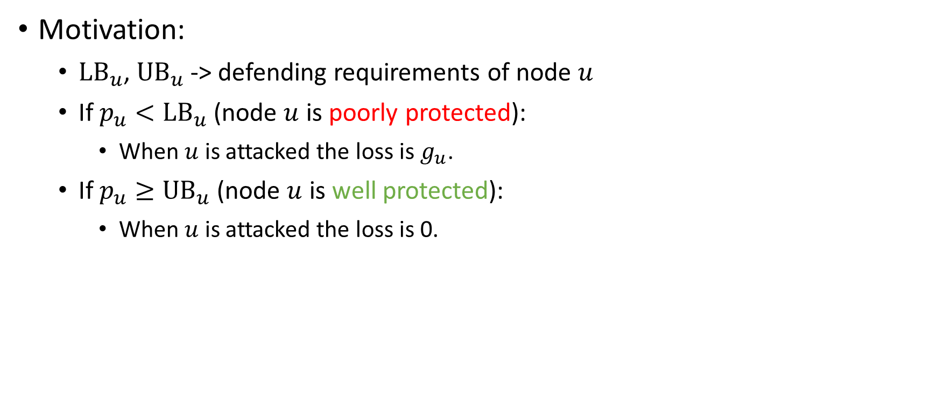
Network Defending Problem
Motivation:
$LB_{u}$, ${UB}_{u}$ -> defending requirements of node $u$
If $p_{u}<LB_{u}$ (node $u$ is poorly protected):
When $u$ is attacked the loss is $g_{u}$.
If $p_{u}≥UB_{u}$ (node $u$ is well protected):
When $u$ is attacked the loss is 0.

Slide 13
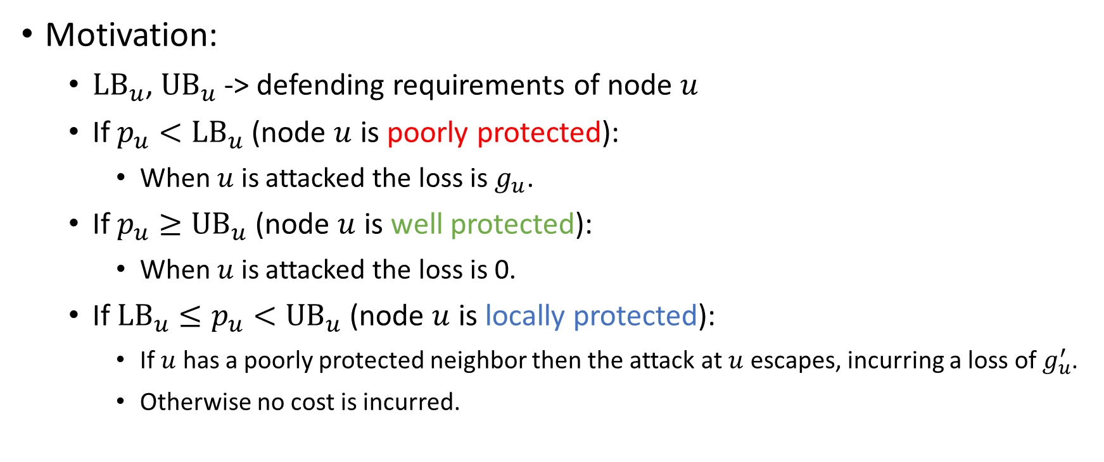
Network Defending Problem
Motivation:
$LB_{u}$, ${UB}_{u}$ -> defending requirements of node $u$
If $p_{u}<LB_{u}$ (node $u$ is poorly protected):
When $u$ is attacked the loss is $g_{u}$.
If $p_{u}≥UB_{u}$ (node $u$ is well protected):
When $u$ is attacked the loss is 0.
If $LB_{u}≤p_{u}<UB_{u}$ (node $u$ is locally protected):
If $u$ has a poorly protected neighbor then the attack at $u$ escapes, incurring a loss of $g_{u}^{′}$.
Otherwise no cost is incurred.

Slide 14

Network Defending Problem
Example: $LB=4$, $UB=6$, $g=2$ and $g′=1$ for all nodes
$$p_{1}=5$$
$$p_{2}=5$$
$$p_{3}=5$$
1
2
3
4
$$p_{5}=7$$
5
6
$$p_{4}=4$$
$$p_{6}=2$$

Slide 15






Network Defending Problem
Example: $LB=4$, $UB=6$, $g=2$ and $g′=1$ for all nodes
$$0$$
$$0$$
$$1$$
$$p_{1}=5$$
$$p_{2}=5$$
$$p_{3}=5$$
1
2
3
4
$$p_{5}=7$$
5
6
$$p_{4}=4$$
$$p_{6}=2$$
$$0$$
$$0$$
$$2$$

Slide 16
Network Defending Problem
Example: $LB=4$, $UB=6$, $g=2$ and $g′=1$ for all nodes
$$0$$
$$0$$
$$1$$
$$p_{1}=5$$
$$p_{2}=5$$
$$p_{3}=5$$
1
2
3
4
$$p_{5}=7$$
5
6
$$p_{4}=4$$
$$p_{6}=2$$
Defending Result
$$0$$
$$0$$
$$2$$

Slide 17
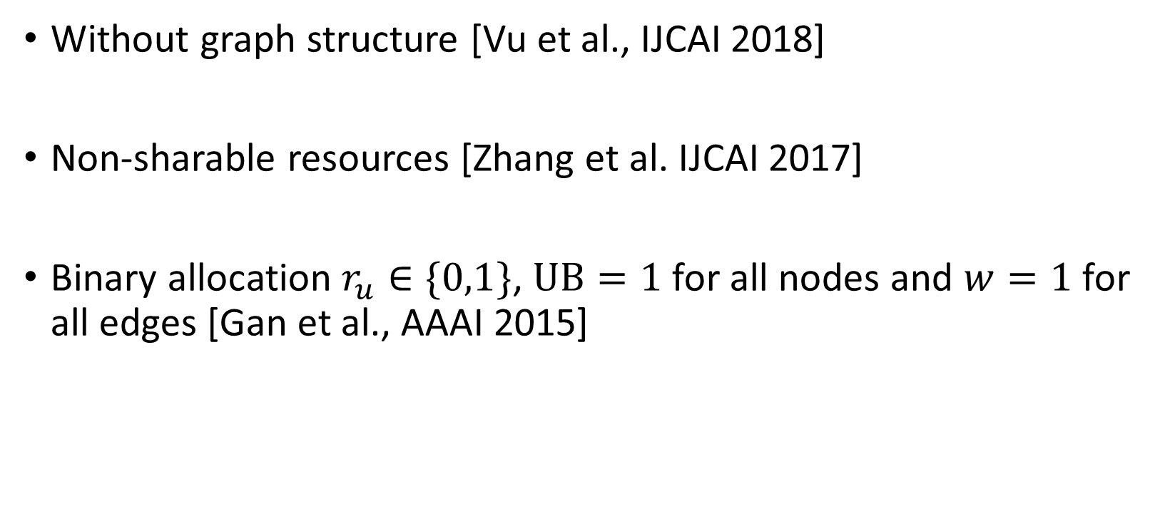
Existing Works
Without graph structure [Vu et al., IJCAI 2018]
Non-sharable resources [Zhang et al. IJCAI 2017]
Binary allocation $r_{u}∈\{0,1\}$, $UB=1$ for all nodes and $w=1$ for all edges [Gan et al., AAAI 2015]

Slide 18

Our Results
Single Threshold Model: ${LB}_{u}={UB}_{u}$ for all nodes $u$
Polynomial time exact algorithm (LP based)

Slide 19

Our Results
Single Threshold Model: ${LB}_{u}={UB}_{u}$ for all nodes $u$
Polynomial time exact algorithm (LP based)
Isolated Model: $w_{uv}=0$ for all edges $\left(u,v\right)∈E$
Polynomial time exact algorithm (Max-flow based)

Slide 20
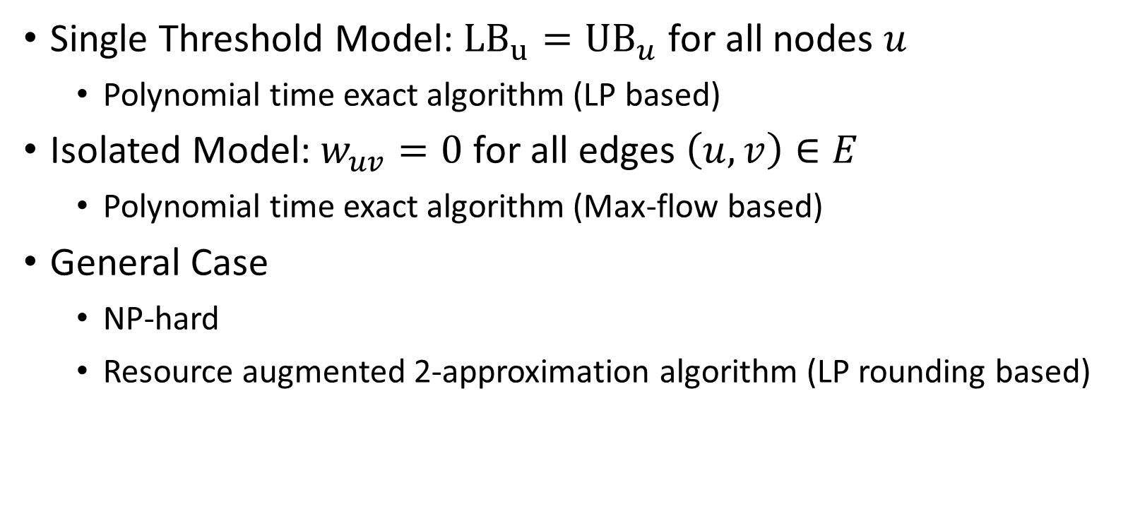
Our Results
Single Threshold Model: ${LB}_{u}={UB}_{u}$ for all nodes $u$
Polynomial time exact algorithm (LP based)
Isolated Model: $w_{uv}=0$ for all edges $\left(u,v\right)∈E$
Polynomial time exact algorithm (Max-flow based)
General Case
NP-hard
Resource augmented 2-approximation algorithm (LP rounding based)

Slide 21

Single Threshold Model
${LB}_{u}={UB}_{u}$ for all nodes $u$
Each node is either protected ($p_{u}≥LB_{u}$) or unprotected ($p_{u}<LB_{u}$)

Slide 22

Single Threshold Model
${LB}_{u}={UB}_{u}$ for all nodes $u$
Each node is either protected ($p_{u}≥LB_{u}$) or unprotected ($p_{u}<LB_{u}$)
Can we achieve defending result at most $α$?

Slide 23
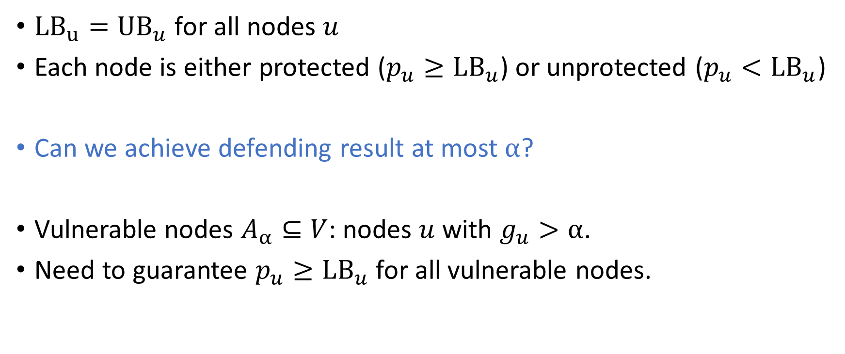
Single Threshold Model
${LB}_{u}={UB}_{u}$ for all nodes $u$
Each node is either protected ($p_{u}≥LB_{u}$) or unprotected ($p_{u}<LB_{u}$)
Can we achieve defending result at most $α$?
Vulnerable nodes $A_{α}⊆V$: nodes $u$ with $g_{u}>α$.
Need to guarantee $p_{u}≥LB_{u}$ for all vulnerable nodes.

Slide 24
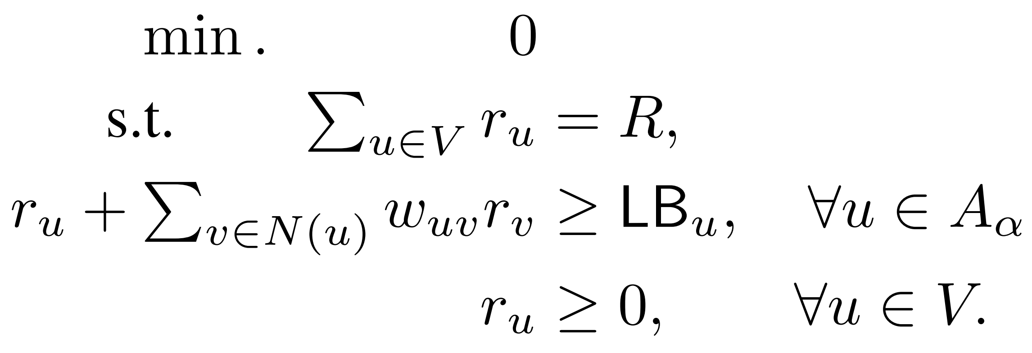

Single Threshold Model
Linear program (LP) formulation for fixed $α$:
Binary search for the minimum achievable $α$.

Slide 25

Isolated Model
Isolated Model: $w_{uv}=0$ for all edges $\left(u,v\right)∈E$
Defending power $p_{u}=r_{u}$ for all $u∈V$

Slide 26

Isolated Model
Isolated Model: $w_{uv}=0$ for all edges $\left(u,v\right)∈E$
Defending power $p_{u}=r_{u}$ for all $u∈V$
Can we achieve defending result at most $α$?

Slide 27
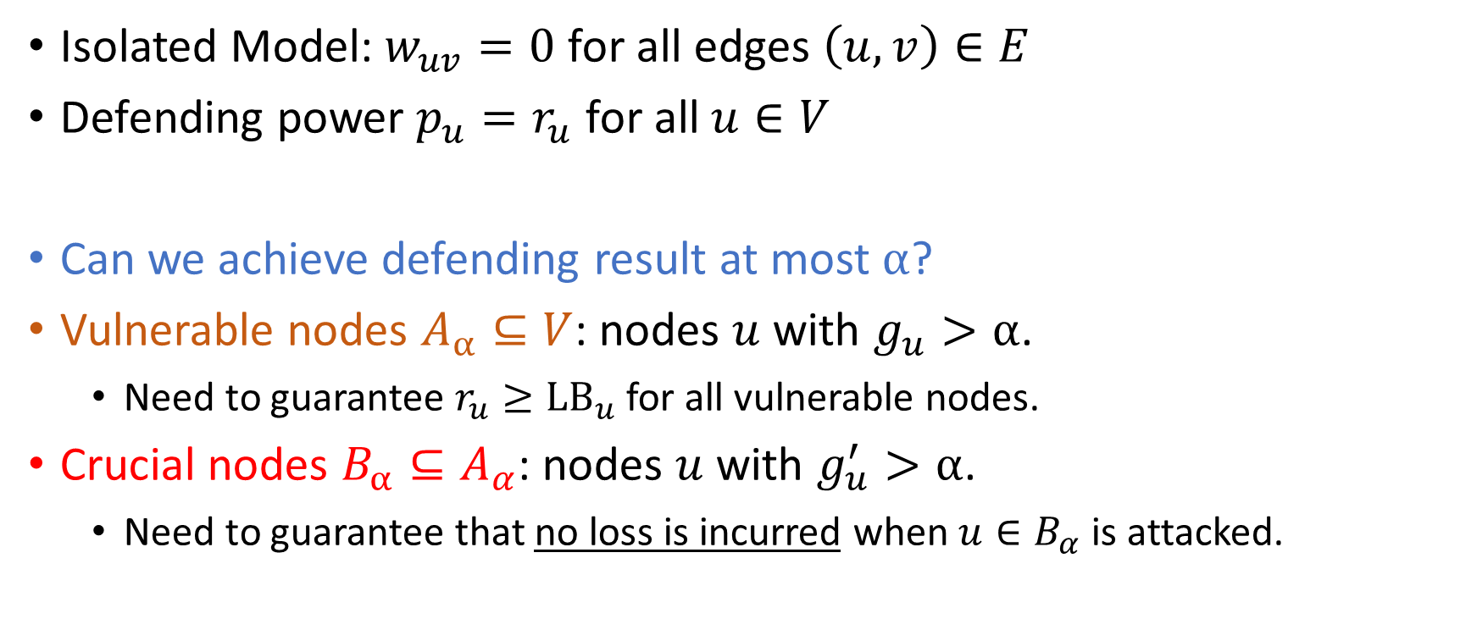
Isolated Model
Isolated Model: $w_{uv}=0$ for all edges $\left(u,v\right)∈E$
Defending power $p_{u}=r_{u}$ for all $u∈V$
Can we achieve defending result at most $α$?
Vulnerable nodes $A_{α}⊆V$: nodes $u$ with $g_{u}>α$.
Need to guarantee $r_{u}≥LB_{u}$ for all vulnerable nodes.
Crucial nodes $B_{α}⊆A_{α}$: nodes $u$ with $g_{u}^{′}>α$.
Need to guarantee that no loss is incurred when $u∈B_{α}$ is attacked.

Slide 28







Isolated Model
Algorithm: decide $S⊆B_{α}$ such that
For all $u∈S$: $r_{u}≥UB_{u}$.
For all $u∈B_{α}∖S$: $r_{u}≥{LB}_{u}$ and for all neighbour $v$ of $u$: $r_{v}≥LB_{v}$.
$$V$$
$$u$$
$$v$$
$$A_{α}$$
$$B_{α}$$
$$S$$

Slide 29
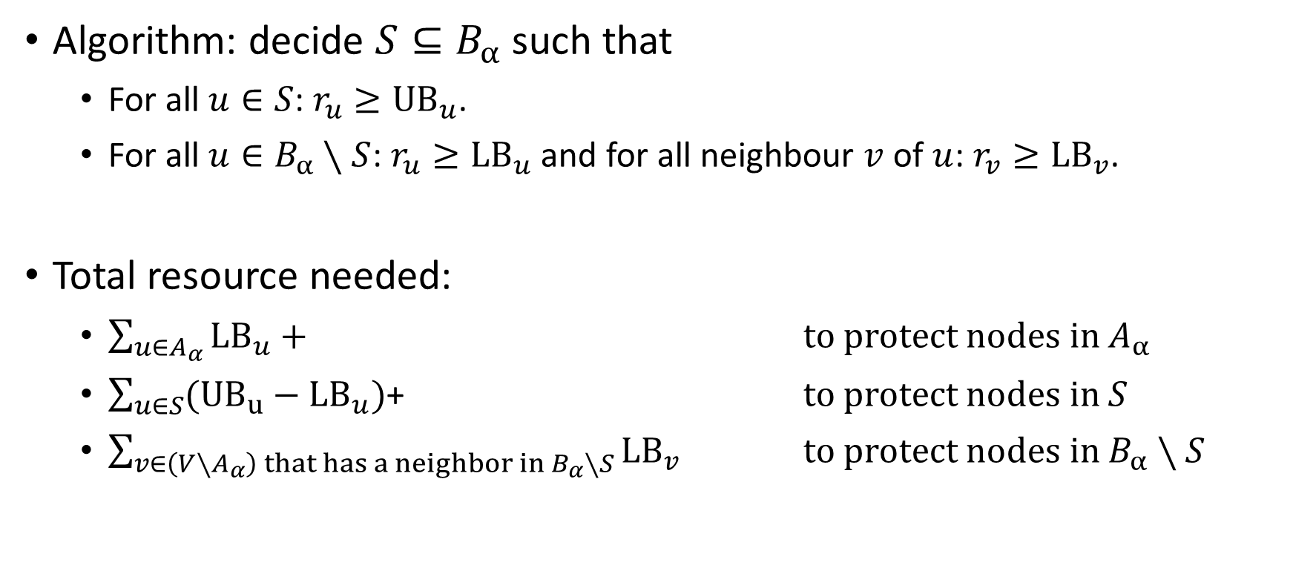
Isolated Model
Algorithm: decide $S⊆B_{α}$ such that
For all $u∈S$: $r_{u}≥UB_{u}$.
For all $u∈B_{α}∖S$: $r_{u}≥{LB}_{u}$ and for all neighbour $v$ of $u$: $r_{v}≥LB_{v}$.
Total resource needed:
$\sum_{{u∈A}_{α}}{LB_{u}}+$ to protect nodes in $A_{α}$
$\sum_{u∈S}{({UB}_{u}−LB_{u})}$+ to protect nodes in $S$
$\sum_{v∈\left(V∖A_{α}\right) that has a neighbor in B_{α}∖S}{LB_{v}}$ to protect nodes in $B_{α}∖S$

Slide 30
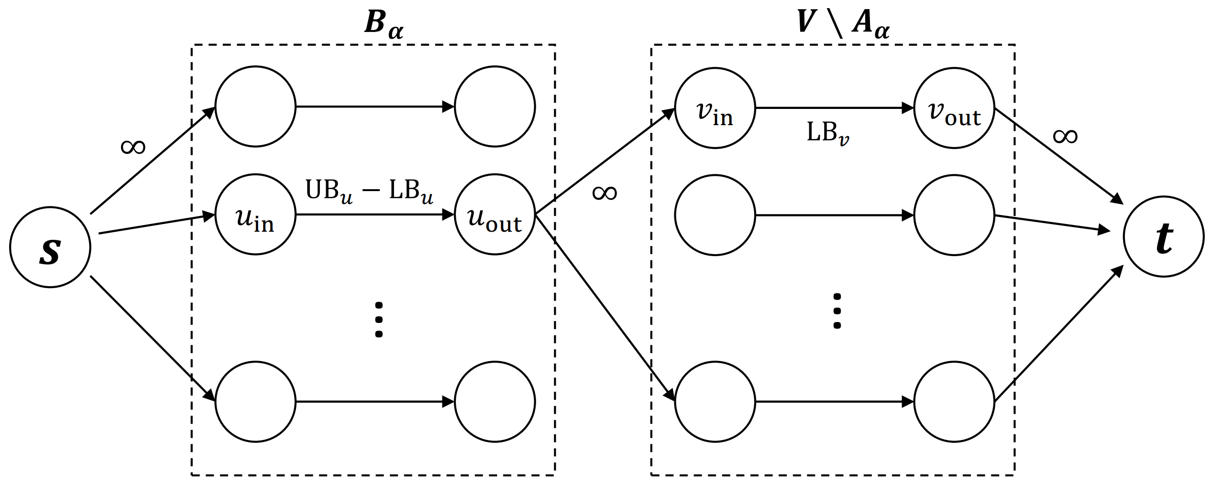
Isolated Model
Flow Network:

Slide 31
Isolated Model
Maximum Flow = Minimum Cut.
Claim:
(1) Any (s-t)-cut defines a defending strategy.
(2) The value of the cut = total resource needed.

Slide 32
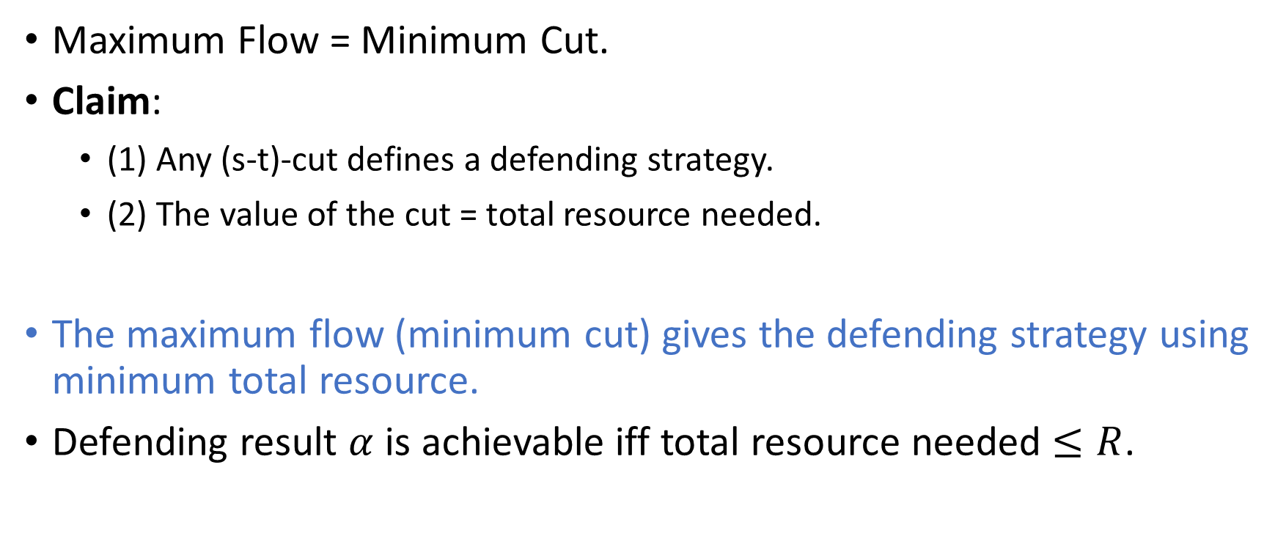
Isolated Model
Maximum Flow = Minimum Cut.
Claim:
(1) Any (s-t)-cut defines a defending strategy.
(2) The value of the cut = total resource needed.
The maximum flow (minimum cut) gives the defending strategy using minimum total resource.
Defending result $α$ is achievable iff total resource needed $≤R$.

Slide 33
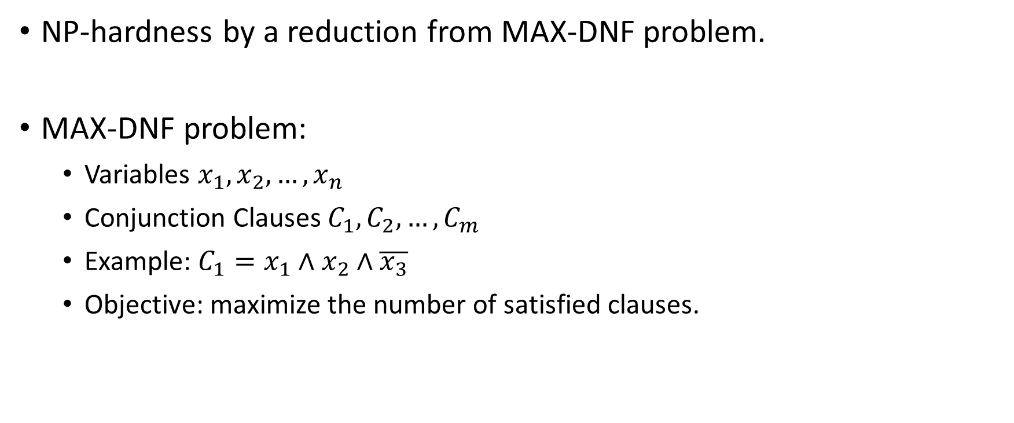
General Case
NP-hardness by a reduction from MAX-DNF problem.
MAX-DNF problem:
Variables $x_{1},x_{2},…,x_{n}$
Conjunction Clauses $C_{1},C_{2},…,C_{m}$
Example: $C_{1}=x_{1}∧x_{2}∧\overline{x_{3}}$
Objective: maximize the number of satisfied clauses.

Slide 34
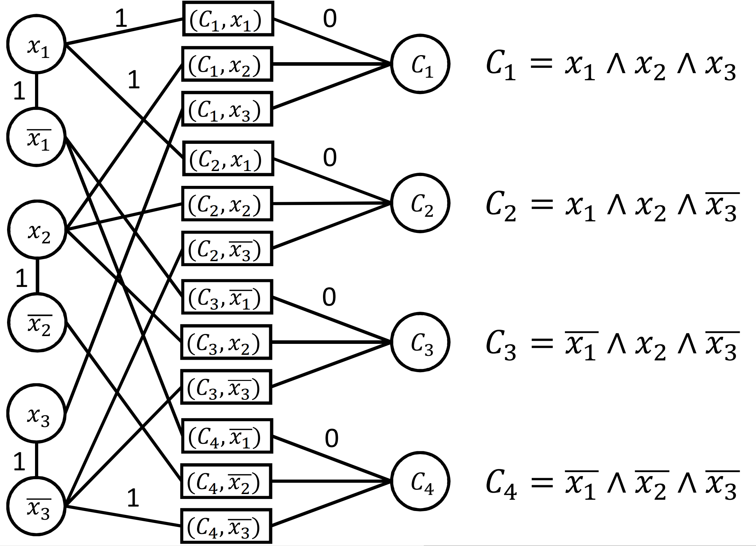
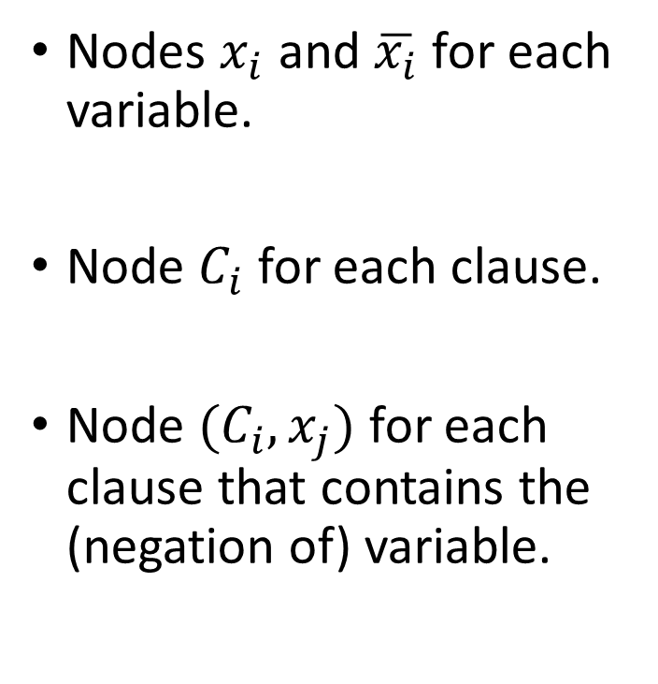
Reduction
Nodes $x_{i}$ and $\overline{x_{i}}$ for each variable.
Node $C_{i}$ for each clause.
Node $(C_{i},x_{j})$ for each clause that contains the (negation of) variable.

Slide 35
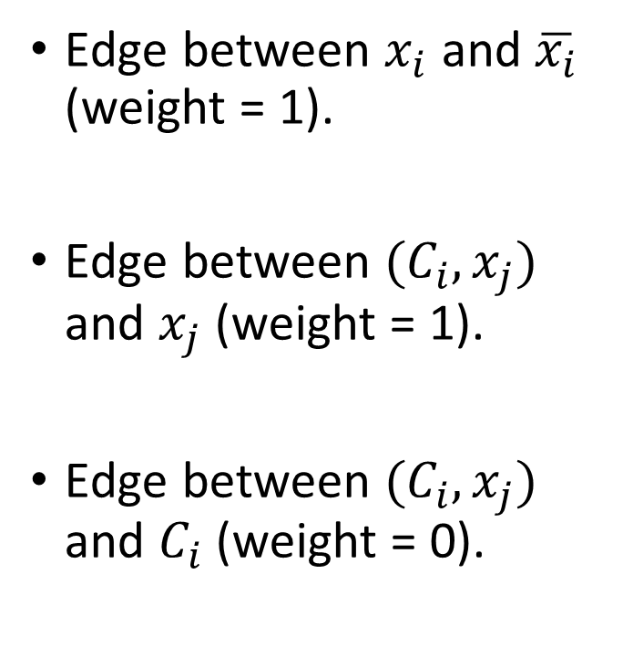
Reduction
Edge between $x_{i}$ and $\overline{x_{i}}$ (weight = 1).
Edge between $(C_{i},x_{j})$ and $x_{j}$ (weight = 1).
Edge between $(C_{i},x_{j})$ and $C_{i}$ (weight = 0).

Slide 36
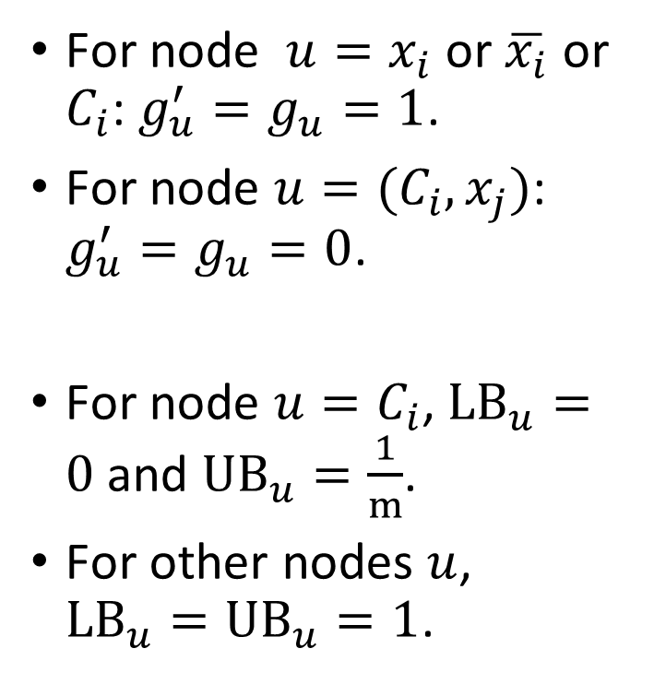
Reduction
For node $u=x_{i}$ or $\overline{x_{i}}$ or $C_{i}$: $g_{u}^{′}=g_{u}=1$.
For node $u=(C_{i},x_{j})$: ${g_{u}^{′}=g}_{u}=0$.
For node $u=C_{i}$, $LB_{u}=0$ and $UB_{u}=\frac{1}{m}$.
For other nodes $u$, $LB_{u}=UB_{u}=1$.

Slide 37
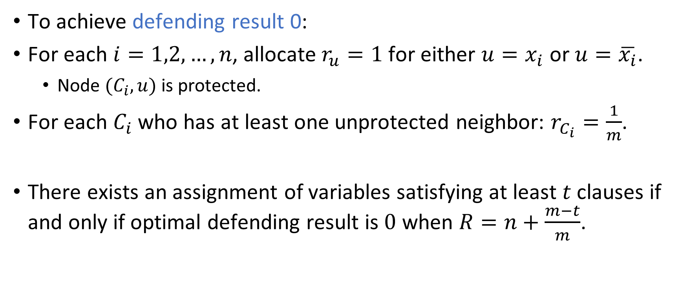
Reduction
To achieve defending result 0:
For each $i=1,2,…, n$, allocate $r_{u}=1$ for either $u=x_{i}$ or $u=\overline{x_{i}}$.
Node $(C_{i},u)$ is protected.
For each $C_{i}$ who has at least one unprotected neighbor: $r_{C_{i}}=\frac{1}{m}$.
There exists an assignment of variables satisfying at least $t$ clauses if and only if optimal defending result is $0$ when $R=n+\frac{m−t}{m}$.

Slide 38

General Case
NP-hardness by a reduction from MAX-DNF problem.
It is NP-hard to distinguish between $OPT=0$ and $OPT>0$.

Slide 39

General Case
NP-hardness by a reduction from MAX-DNF problem.
It is NP-hard to distinguish between $OPT=0$ and $OPT>0$.
It is NP-hard to give any approximation algorithm.

Slide 40
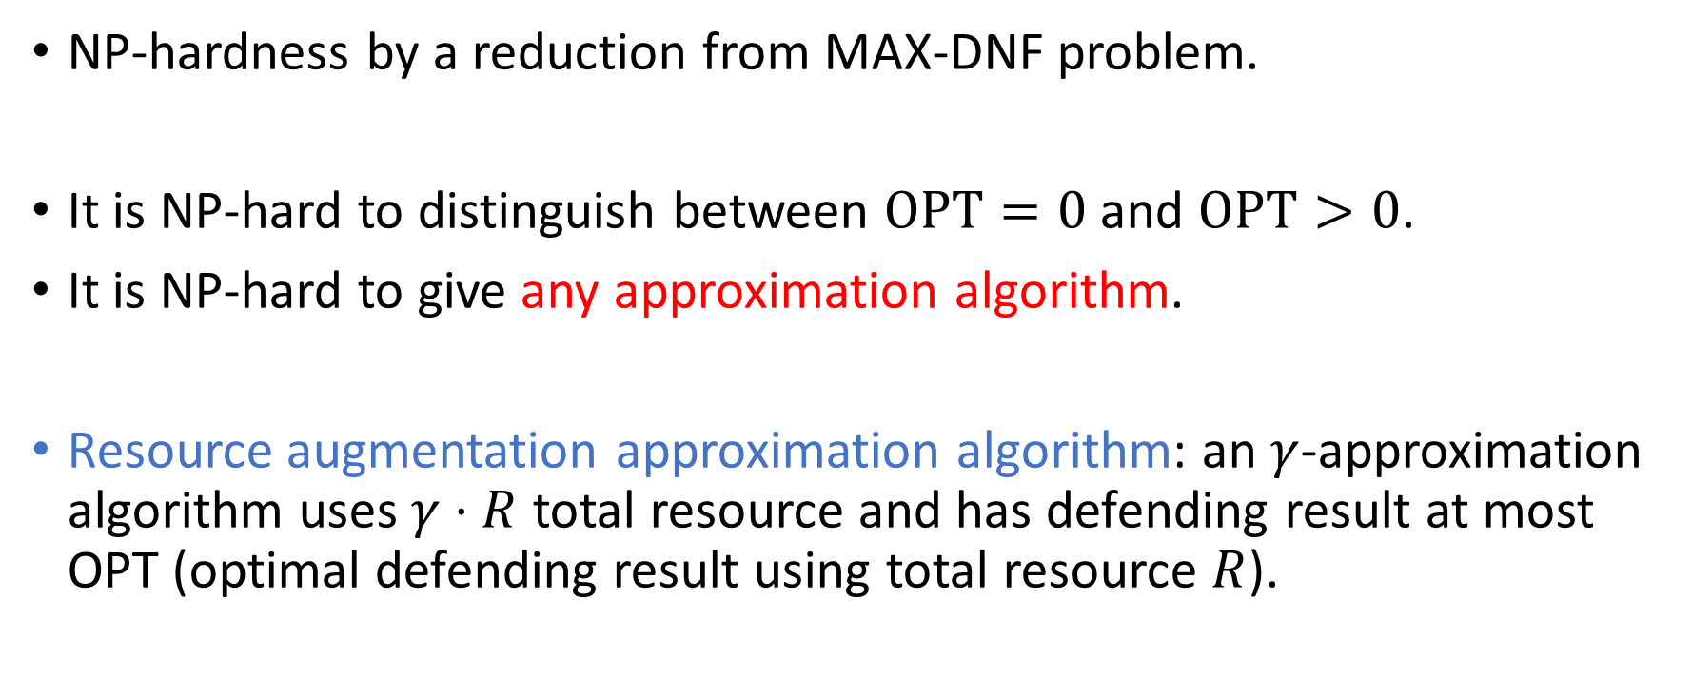
General Case
NP-hardness by a reduction from MAX-DNF problem.
It is NP-hard to distinguish between $OPT=0$ and $OPT>0$.
It is NP-hard to give any approximation algorithm.
Resource augmentation approximation algorithm: an $γ$-approximation algorithm uses $γ⋅R$ total resource and has defending result at most OPT (optimal defending result using total resource $R$).

Slide 41
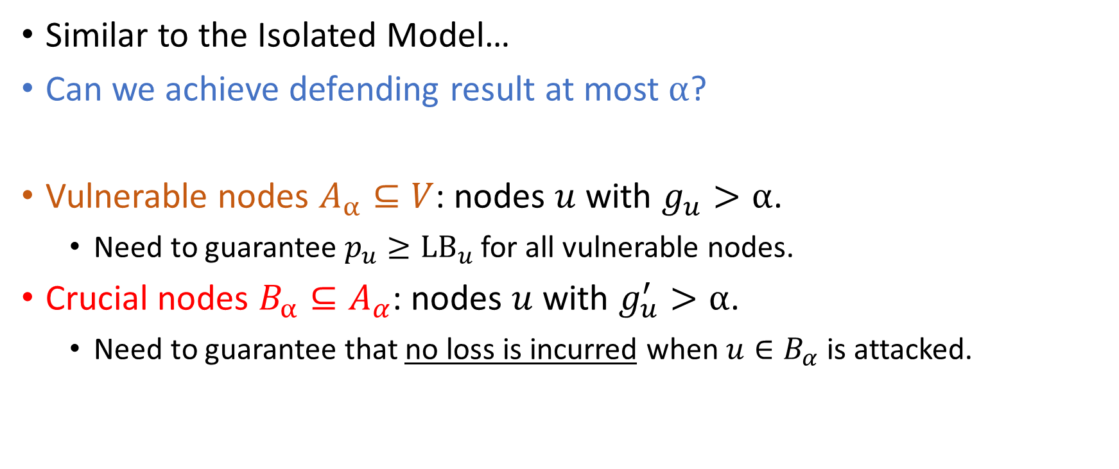
General Case
Similar to the Isolated Model…
Can we achieve defending result at most $α$?
Vulnerable nodes $A_{α}⊆V$: nodes $u$ with $g_{u}>α$.
Need to guarantee $p_{u}≥LB_{u}$ for all vulnerable nodes.
Crucial nodes $B_{α}⊆A_{α}$: nodes $u$ with $g_{u}^{′}>α$.
Need to guarantee that no loss is incurred when $u∈B_{α}$ is attacked.

Slide 42







General Case
Similar to the Isolated Model…
Algorithm: decide $S⊆B_{α}$ such that
For all $u∈S$: $p_{u}≥UB_{u}$.
For all $u∈B_{α}∖S$: $p_{u}≥{LB}_{u}$ and for all neighbour $v$ of $u$: $p_{v}≥LB_{v}$.
$$V$$
$$u$$
$$v$$
$$A_{α}$$
$$B_{α}$$
$$S$$

Slide 43
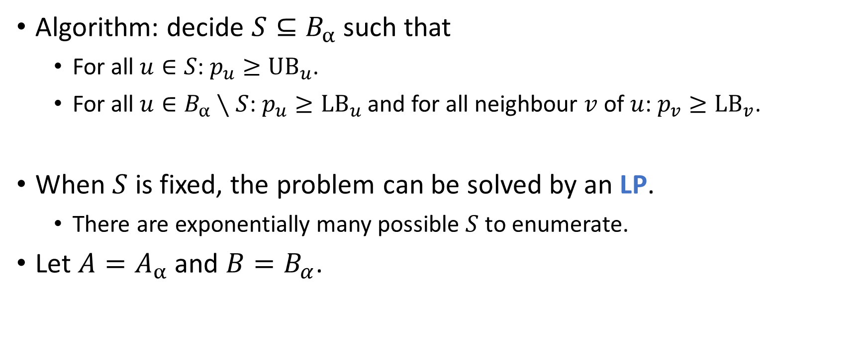
General Case
Algorithm: decide $S⊆B_{α}$ such that
For all $u∈S$: $p_{u}≥UB_{u}$.
For all $u∈B_{α}∖S$: $p_{u}≥{LB}_{u}$ and for all neighbour $v$ of $u$: $p_{v}≥LB_{v}$.
When $S$ is fixed, the problem can be solved by an LP.
There are exponentially many possible $S$ to enumerate.
Let $A=A_{α}$ and $B=B_{α}$.

Slide 44
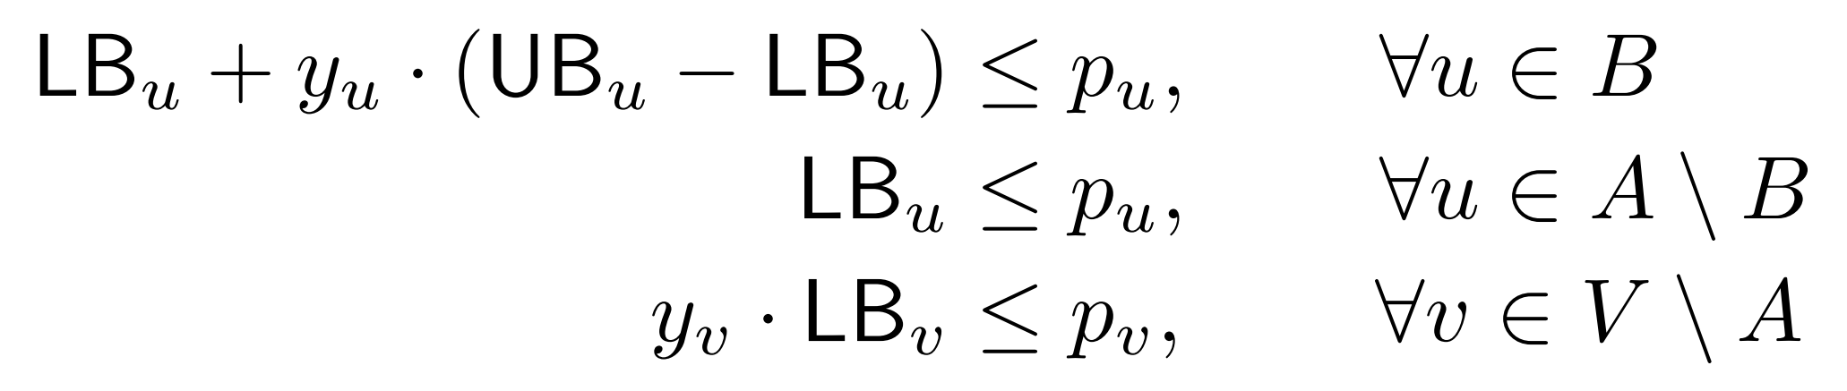

Integer Program Formulation
Introduce an indicator $y_{u}∈\{0,1\}$ for each node $u∈B$.
$y_{u}=1$ means $u∈S$ ($p_{v}≥UB_{u}$).
Introduce an indicator $y_{v}∈\{0,1\}$ for each node $v∈V∖A$.
$y_{v}=1$ means $p_{v}≥LB_{v}$.

Slide 45
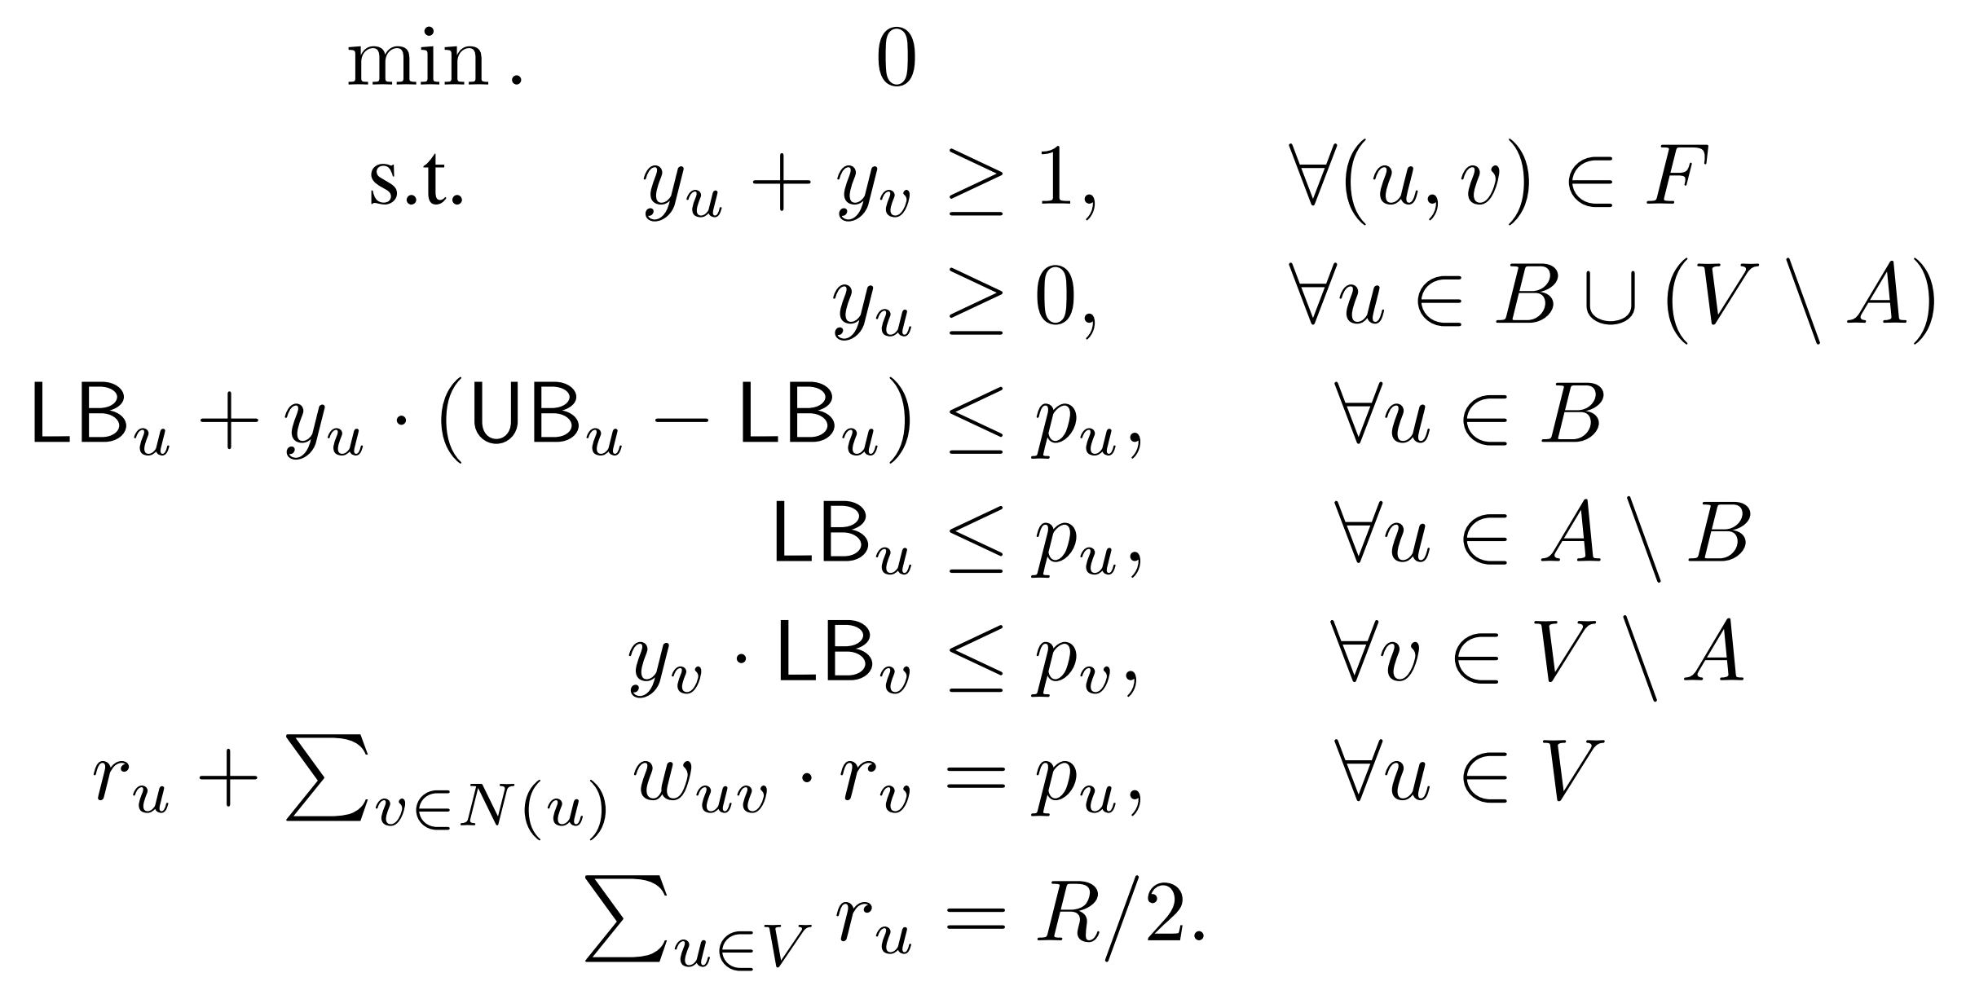
LP Relaxation

Slide 46
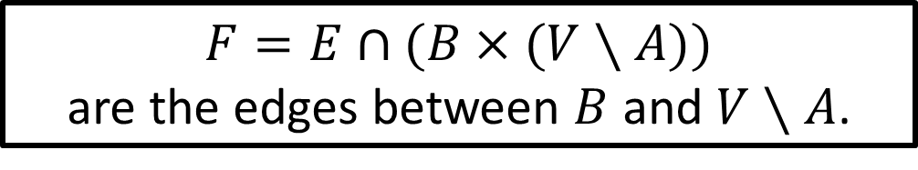
LP Relaxation
$F=E∩(B×(V∖A))$
are the edges between $B$ and $V∖A$.

Slide 47
LP Relaxation

Slide 48
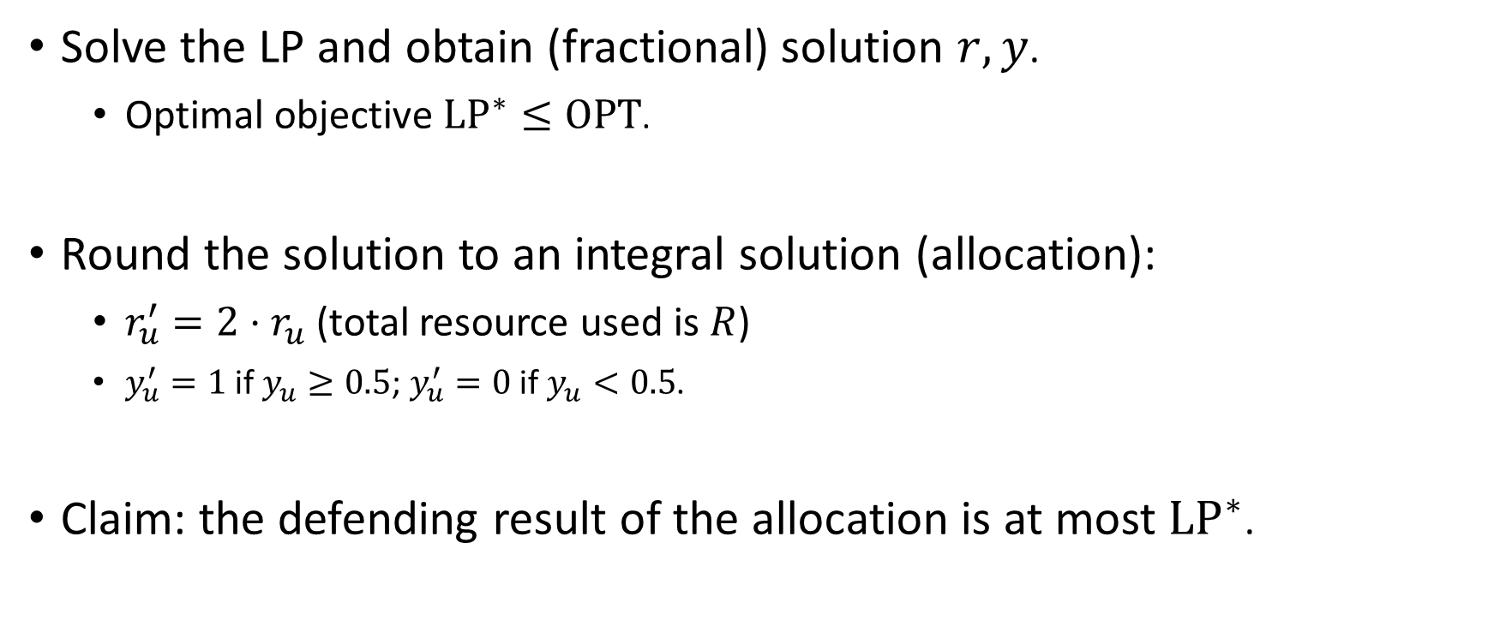
Rounding the Optimal LP Solution
Solve the LP and obtain (fractional) solution $r, y$.
Optimal objective $LP^{∗}≤OPT$.
Round the solution to an integral solution (allocation):
$r_{u}^{′}=2⋅r_{u}$ (total resource used is $R$)
$y_{u}^{′}=1$ if $y_{u}≥0.5$; $y_{u}^{′}=0$ if $y_{u}<0.5$.
Claim: the defending result of the allocation is at most $LP^{∗}$.

Slide 49
Future Directions
Defending against contagious attacks, e.g., the attack at a node spreads to its neighborhoods, and causes damage at multiple nodes.
NP-hard to compute the optimal defending strategy.
What if resources can only be transferred between neighbors, instead of being shared.
NP-hard to compute the optimal reallocation, even for a fixed allocation and a node under attack.

Slide 50
Thanks!
Questions?

